Slide 1

Web Development: Frontend vs. Backend Technologies
Presented by : Karan Songara

Slide 2
Introduction to Web Development
Web development is the intricate process of building the digital experiences users engage with every single day. From responsive websites to dynamic web applications, it's the invisible architecture behind our online world. This vast field is primarily segmented into two core areas, each with unique responsibilities and skill sets.

Slide 3

What is Frontend Development?
Frontend development, also known as client-side development, is all about creating the visual and interactive elements that users see and engage with directly in their web browser.
HTML (Hypertext Markup Language)
CSS (Cascading Style Sheets)
JavaScript

Slide 4
Popular Frontend Frameworks & Libraries
React
Angular
A JavaScript library by Facebook for building dynamic user interfaces with reusable components. Known for its declarative views and efficient data rendering.
A comprehensive framework by Google, ideal for large-scale enterprise applications. Offers a structured approach with features like data binding and dependency injection.
Used by: Instagram, Discord, Bloomberg
Used by: Microsoft Office, PayPal
Vue.js
Next.js
A progressive framework known for its simplicity and flexibility. It's lightweight, easy to learn, and highly adaptable for various project sizes.
A React-based framework enables server-side rendering (SSR) and static site generation (SSG), improving performance and SEO for modern web applications.
Used by: Netflix, Adobe
Used by: Apple, Walmart

Slide 5

What is Backend
Development?
Backend development, often referred to as server-side development, is the unseen force that powers web applications. It's responsible for the "behind-the-scenes" functionality that users don't directly interact with, but which is absolutely essential for a website to function.
Data Processing: Handling and transforming data received from the frontend or external services.
Authentication & Authorization: Securing user accounts and managing access permissions.
API Development: Creating interfaces for different parts of an application or external services to communicate.
Server Management: Ensuring the application runs smoothly and efficiently on the server.

Slide 6
Backend Databases
Databases are the backbone of any dynamic web application, serving as organised repositories for storing, managing, and retrieving crucial information. Backend developers play a pivotal role in designing efficient database schemas and optimising queries to ensure rapid data access and reliability.
SQL Databases | NoSQL Databases
Relational databases that store data in structured tables with predefined schemas. Ideal for complex queries and ensuring data integrity. | Non-relational databases that offer flexible schemas, enabling horizontal scaling and handling large volumes of unstructured data
MySQL: Widely used open-source relational database. | MongoDB: Document-oriented database popular for its flexibility and scalability.
PostgreSQL: Advanced open-source relational database known for extensibility and standards compliance. | Redis: In-memory data structure store used as a database, cache, and message broker for high-speed operations.

Slide 7

Frontend vs. Backend – Key Differences
While both frontend and backend are integral to web development, they operate in distinct spheres with different concerns and technical stacks. Understanding these differences is crucial for effective project planning and team collaboration.
Frontend Development
Focus: User interface (UI), visual design, and user interaction.
Runs In: The user's web browser (client-side).
Key Responsibilities: Layouts, styles, animations, interactive forms, and ensuring responsiveness across devices.
Backend Development
Focus: Server logic, database interactions, and application performance.
Runs On: Servers (server-side).
Key Responsibilities: Data storage and retrieval, user authentication, business logic, and API management.

Slide 8

Full Stack Development
In the dynamic world of web development, a "full stack developer" is an increasingly sought-after professional who possesses expertise across both frontend and backend technologies. They are capable of handling every stage of web application development, from conceptualisation to deployment.

Slide 9
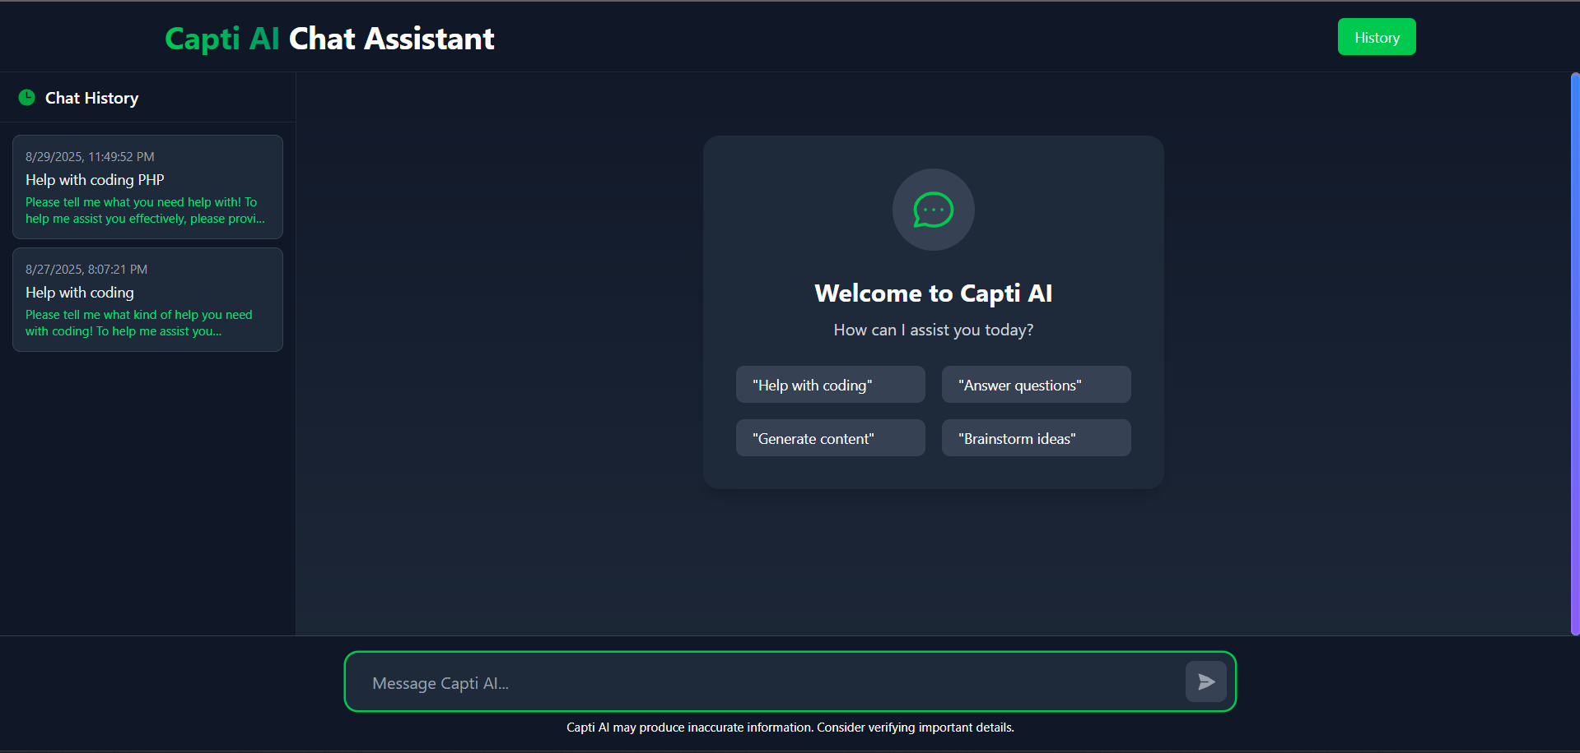


Slide 10
THANK YOU

